Slide 1






STUDENT ORIENTATION
MELBOURNE CBD CAMPUS​
Trimester 4, 2025
A very warm welcome to our New Students from the UBSS Staff.

Slide 2
Today’s Topics
  Welcome message
  Introduction to UBSS
  Living in Australia
  Living in Melbourne
  Our Melbourne CBD Campus
  Key UBSS Staff
  Academic Support Services
  Non-Academic Support Services
  Communication
  Important Procedures
  Facilities and Resources
  Policies and Procedures
  Reminders

Slide 3

Acknowledgement of Country
We acknowledge the Traditional Custodians of the lands and waters across Australia where our campuses are located and where we gather to meet and learn. Today, I honour the Gadigal people of the Eora Nation, on whose land we are based and all the lands we gather from today.
We pay respect to Elders past and present, whose wisdom, cultural heritage and care for these lands have guided countless generations, just as we strive to guide our students. Inspired by their commitment to learning and community, we walk together toward a future of mutual respect, understanding, and shared opportunity.

Slide 4
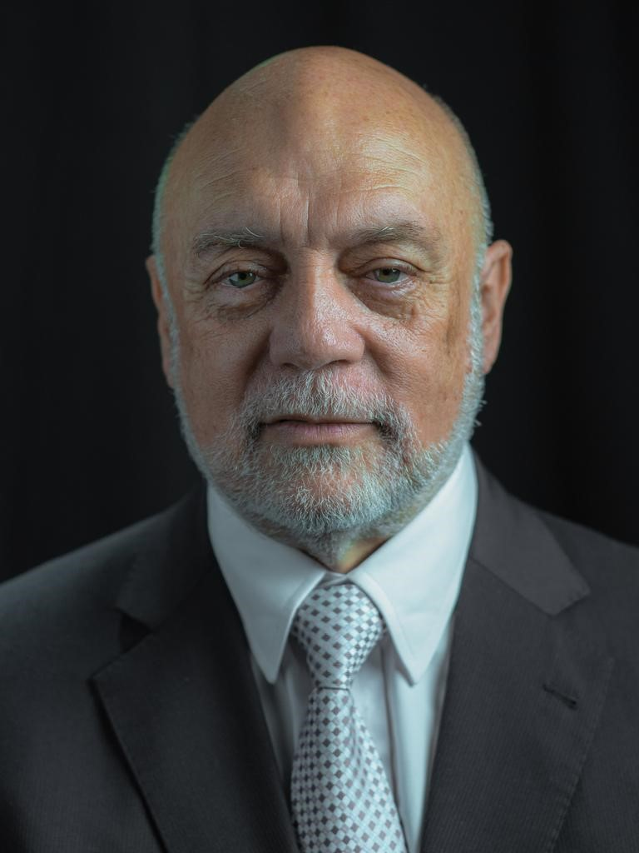
Welcome Message
Dear Students,
Welcome to Universal Business School (UBSS)
You are embarking on an exciting journey of learning and growth. At UBSS, we are dedicated to providing you with the knowledge, skills, and support needed to excel in your chosen field. Our focus is on practical, industry-relevant education, equipping you to thrive in an ever-changing world.
Your time here is a unique opportunity to challenge yourself, explore new ideas, and build lifelong connections. Make the most of it, and remember, our team is here to support you every step of the way.
We are thrilled to have you join our community and can’t wait to see all that you will achieve.
Professor Alan Bowen-James
Interim Chief Executive Officer
Interim Chief Academic Officer
Group Colleges Australia

Slide 5

Introduction to UBSS

Slide 6
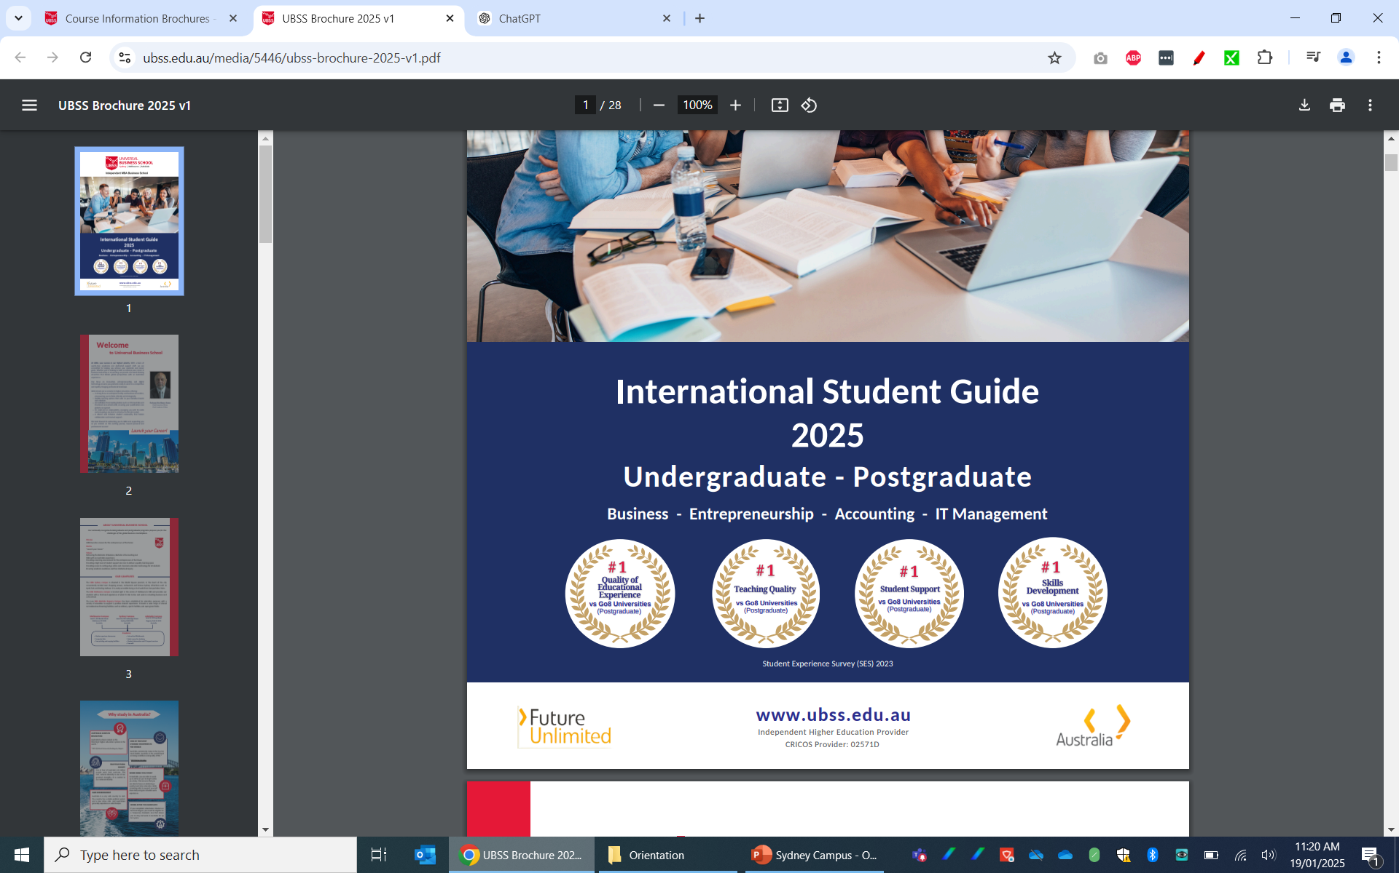

Introduction to UBSS
Student Experience Survey
(2023)
UBSS is a nationally recognised business school and higher
education provider of undergraduate and postgraduate programs that prepare you for the challenges of the global business marketplace.
Our Programs
Bachelor of Accounting
Bachelor of Business
Master of Business Administration (MBA)
  Accounting
  Entrepreneurship
  IT Management

Slide 7
Introduction to UBSS
UBSS Mission
UBSS launches careers for the entrepreneurs of the future
UBSS Motto
“Launch Your Career"
UBSS Values
Delivering the Bachelor of Business, Bachelor of Accounting and MBA with an Australian experience.
Providing a learning environment for the entrepreneurs of the future offering a high level of student support and care to deliver a quality learning space providing access to online and classroom education technology for all students ensuring academic excellence & free intellectual Inquiry.
08

Slide 8
Introduction to UBSS
Our commitment:
It is the School’s objective to prepare you to be work ready in the business world after completion of your degree.

Slide 9
UBSS Governance
Universal Business School Sydney (UBSS) is a trading name of Group Colleges Australia (GCA), an educational institution based in Australia.
The Board of Directors has ultimate responsibility for GCA performance and operations as an accredited higher education provider.
Academic governance is delegated to the Academic Board (AB) by the Board of Directors in accordance with GCA’s Constitution.
Management is delegated to the Chief Executive Officer, who is supported by the Executive Leadership Team and committees that monitor and advise on health and safety, staff and student wellbeing and operational matters.
Governance and Leadership
https://www.ubss.edu.au/about-us/?tab=Governance

Slide 10



UBSS Registration
UBSS is registered as a higher education provider in Australia by the Tertiary Education Quality and Standards Agency (TEQSA). The Tertiary Education Quality and Standards Agency (TEQSA), registers all Australian institutions, including government and private universities, that offer courses at the higher education (tertiary level) and accredits their courses for delivery in Australia and/or offshore locations.
CRICOS is the Commonwealth Register of Institutions and Courses for Overseas Students. CRICOS registration means that UBSS is authorised by the Australian government to enrol international students in its courses.
When you attend university or an approved higher education provider, you can get a FEE-HELP loan to pay all or part of your tuition fees (for Australian citizens and some special New Zealand visa holders only).
Registration and Accreditation
https://www.ubss.edu.au/registration-and-accreditation

Slide 11



Professional Accreditation

Slide 12

Living in Australia
"Australia is a stable, democratic and culturally diverse nation with a highly skilled workforce and one of the strongest performing economies in the world.”
https://www.ubss.edu.au/living-in-australia/
Global Recognition Growing Destination Multicultural Society
Safe Environment Cost of Living Work

Slide 13

Living in Australia
Important information while living in Australia:
Emergency Contacts: 000 (triple zero) = emergency number in Australia
https://www.triplezero.gov.au
Safe work in Australia: Covid 19 information for workplaces
https://covid19.swa.gov.au/covid-19-information-workplaces
Beach Safety: https://www.healthdirect.gov.au/beach-safety
Key facts:
  •Always swim between the red and yellow flags on patrolled beaches
  •Always swim with someone else
  •Never swim after drinking alcohol or taking drugs
Overseas Student Health Insurance:
https://www.studyaustralia.gov.au/en/plan-your-move/overseas-student-health-cover-oshc
Legal Advice: https://studymelbourne.vic.gov.au/living-here/help-in-tough-times/get-legal-advice

Slide 14



Living in Melbourne
“Melbourne is the capital city of Victoria and one of the southern hemisphere’s largest business, cultural, sporting and recreational cities. People living in Melbourne enjoy a safe city, affordable healthcare, world-class education, reliable infrastructure, business opportunities and a healthy environment”
https://liveinmelbourne.vic.gov.au/discover
Study Melbourne Hub: https://www.studymelbourne.vic.gov.au/study-melbourne-hub

Slide 15

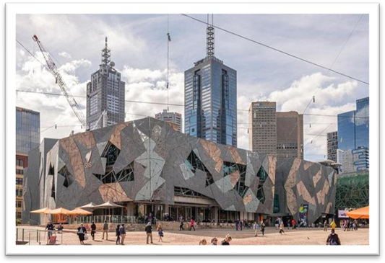

Living in Melbourne
Places to Explore
Melbourne’s unique climate has something for everyone – summers that are warm, autumns that are moderate, winters that are cool, and springs that are sunny and bright. There are also great activities to enjoy. https://liveinmelbourne.vic.gov.au/discover/things-to-do-in-melbourne
Cost of Living - Rent (or other accommodation), utilities, groceries, restaurants and transport. Students should be aware that the costs of studying in Australia will depend on your education provider, the level of study you choose and your study location in Australia.
https://www.studyaustralia.gov.au/en/life-in-australia/living-and-education-costs

Slide 16
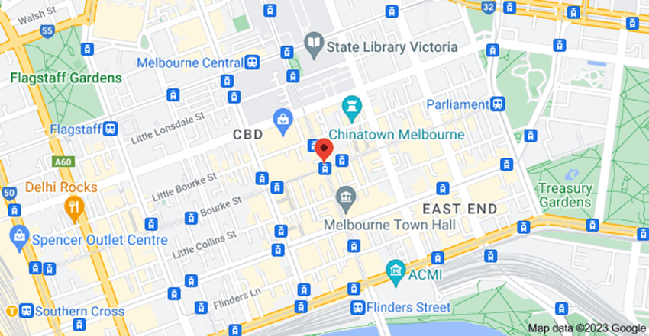
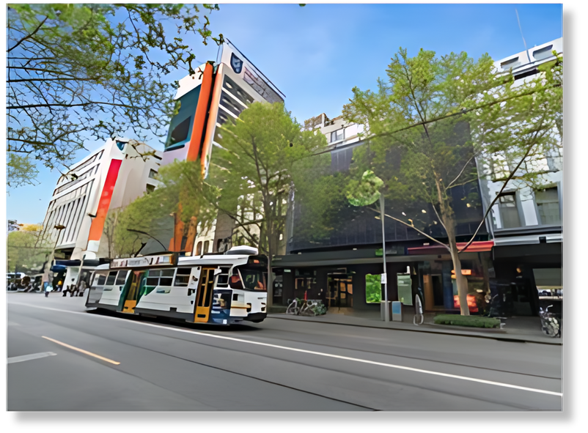
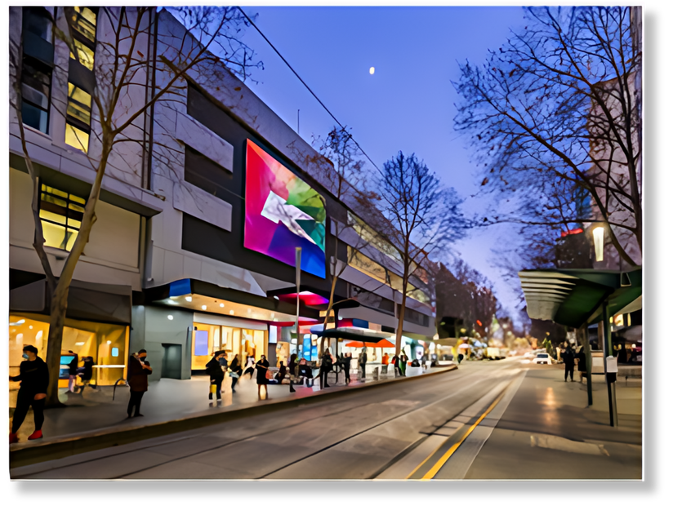
Our Melbourne CBD Campus
The UBSS Melbourne CBD campus is in the heart of the Melbourne CBD, at the intersection of Bourke Street and Swanston Street
Level 2, 222 Bourke Street
Melbourne VIC 3000
Australia

Slide 17

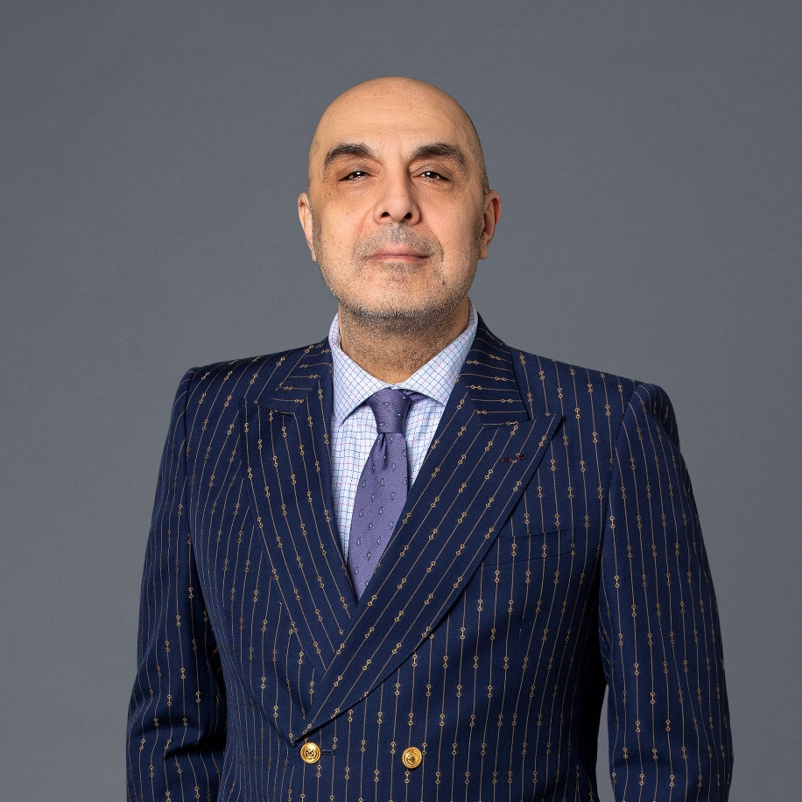
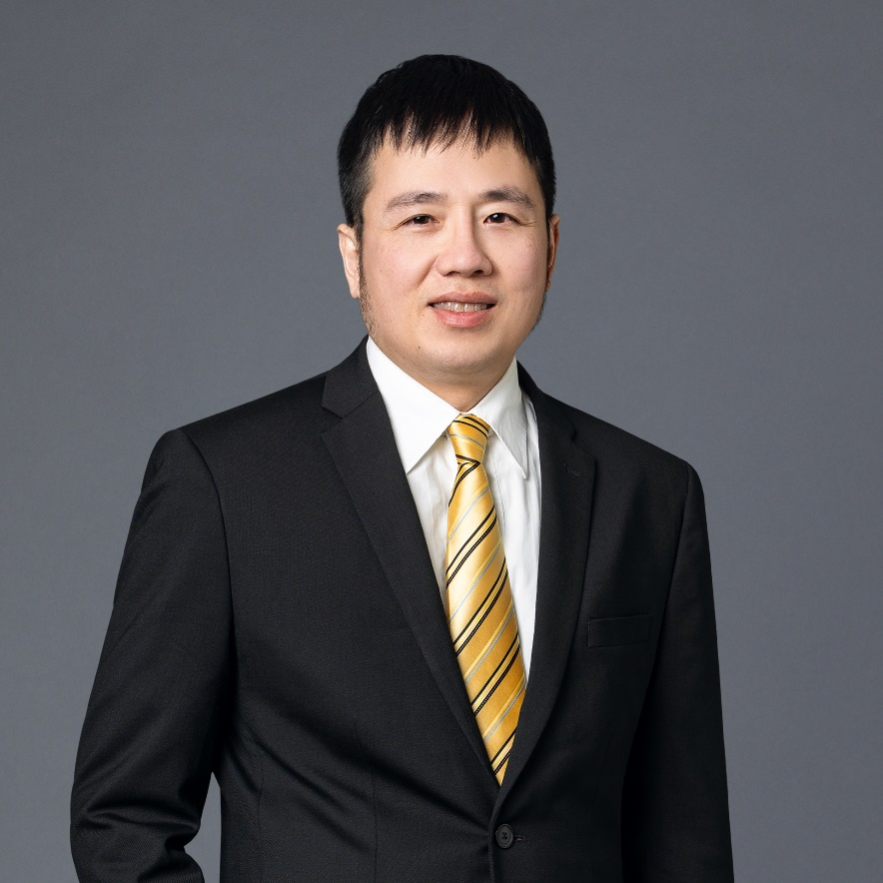
Key UBSS Staff
Associate Professor Wayne Smithson
Academic Programs Director
Subject Matter Expert (SME) Project Lead
Sydney CBD campus
Wayne.Smithson@ubss.edu.au
George Lai
Campus Manager
Compliance Manager
Melbourne CBD campus
George.Lai@ubss.edu.au
Dr Mack Meshkati
Student Success Manager / Senior Lecturer
Melbourne CBD Campus
Mack.Meshkati@ubss.edu.au

Slide 18
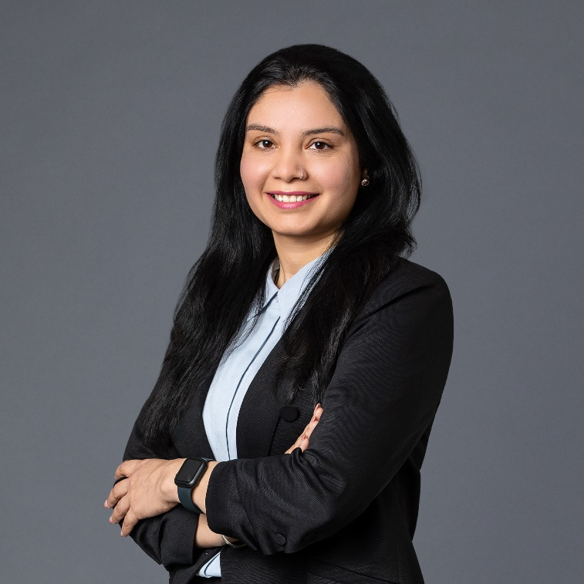

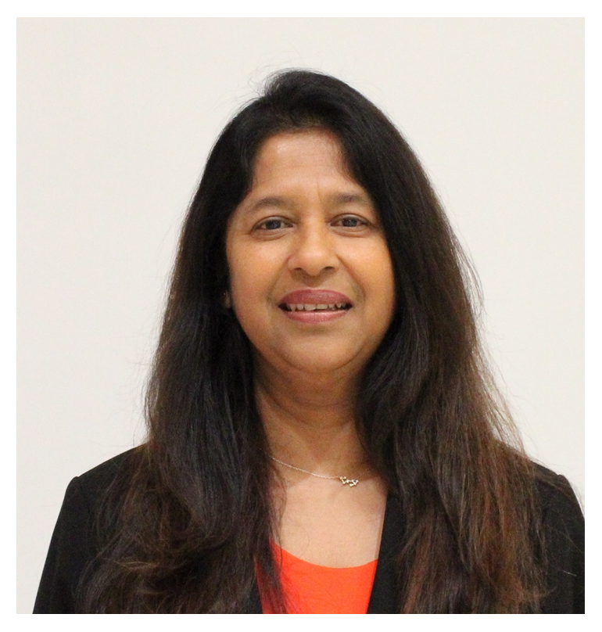
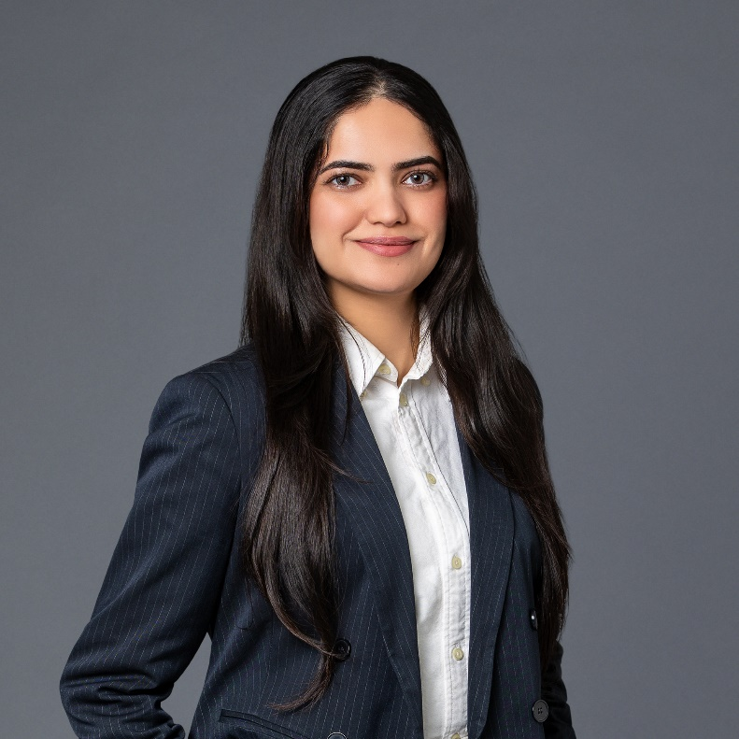
Key UBSS Melbourne Staff
Jaspreet Kaur
Business Analyst
Melbourne CBD Campus
Jaspreet.Kaur@ubss.edu.au
Dr Narjess Abroun
Academic Lead
Melbourne CBD Campus
Narjess.Abroun@ubss.edu.au
Dr Dimuthu Ekanayake
Deputy Student Success Manager
Melbourne CBD Campus
Dimuthu.Ekanayake@gca.edu.au
Muskanpreet Kaur
Student Services Officer
Melbourne CBD Campus
Muskanpreet.Kaur@ubss.edu.au

Slide 19
Melbourne Campus Lift Access
Students are advised that the lifts to go to level 2 are locked daily for the safety and security of all staff and students on campus.
Monday, Friday: 4:30pm
Tuesday, Wednesday, Thursday: 7:30pm
Evening classes: If students wish to leave the campus after 7pm, re-entry to the campus is not possible.

Slide 20
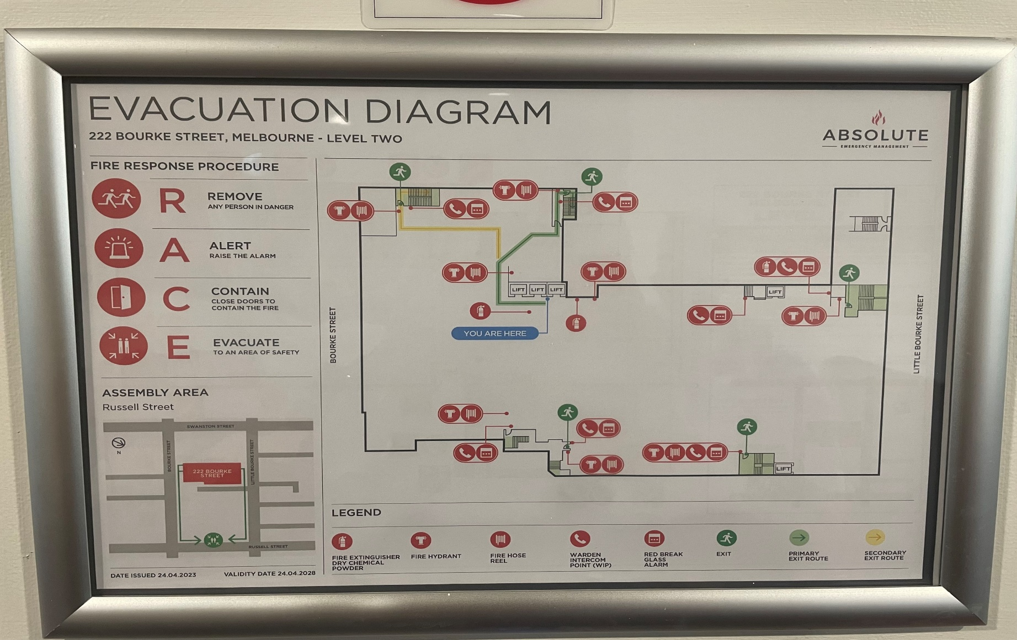
Campus Evacuation Procedure
Evacuation Plans are posted near the lifts and around the campus.
During an evacuation, please remain calm, follow staff instructions, and proceed quickly to the designated assembly point for your safety.
Fire wardens:
Muskanpreet Kaur
George Lai
Gaurav Gulati
Barun Ojha
George Zhang

Slide 21
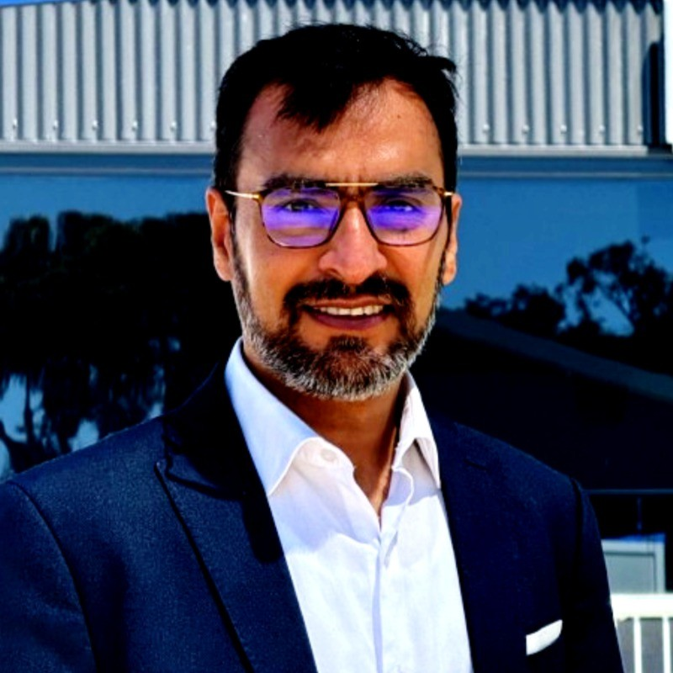
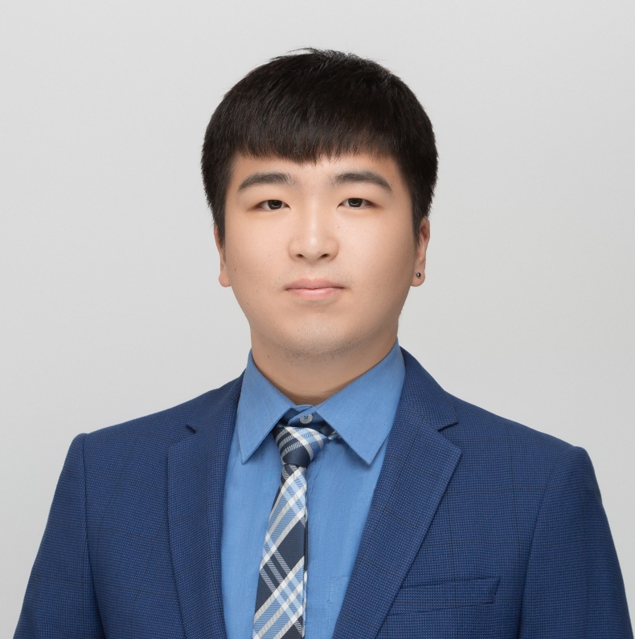
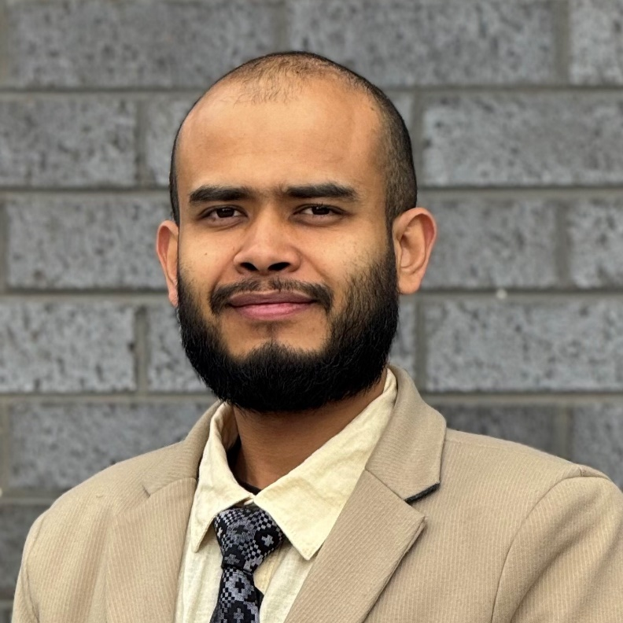
Campus Evacuation Procedure
First aiders:
Muskanpreet Kaur
Jaspreet Kaur
Gaurav Gulati
Barun Ojha
George Zhang
Gaurav Gulati
Student Services & Duty Officer
Gaurav.Gulati@ubss.edu.au
George Zhang
Student Recruitment Officer & Duty Officer
George.Zhang@ubss.edu.au
Barun Ojha
Duty Officer
Barun.Ojha@ubss.edu.au

Slide 22
Powerboards and extension cables
Students are advised to fully charge their electronic devices before attending classes and assessments. Powerboards and extension cables will not be provided.

Slide 23
Academic Support Services
Support for Students Policy: https://www.ubss.edu.au/media/5147/ubss-support-for-students-policy-v1.pdf

Slide 24


Academic Staff Roles
The Lecturer will be responsible for:
  Direct teaching on their specialist subject
  Creating teaching materials
The Tutor will be responsible for:
  Delivering the tutorial materials
  Invigilating in-class assessments for their subject cohort
  Mark all assessments
The Student Success Manager will be responsible for:
  Supporting students' academic growth and success
  Providing academic support and tailored learning assistance

Slide 25
Student Success
Focus areas include –
  Assisting students with their learning and associated skills development;
  Providing individual advise and guidance to students on a range of matters academic;
  Providing individual consultation with students as required;
  Providing lecture and tutorial support as required;
  Assisting with bookings as required;
  Working co-operatively with the campus staff to create a positive and welcoming environment; and taking an active role in hybrid and face to face supervision.

Slide 26
Other Student Success Services
Academic Progression Monitoring and Intervention Policy https://www.ubss.edu.au/policies-and-procedures/
Learning Resources/ Student Central https://www.ubss.edu.au/student-central/
Reading Subjects https://www.ubss.edu.au/student-central/
Video recordings of class lectures via Moodle
E-libraries https://www.ubss.edu.au/e-libraries/
MBA TV for subject content support https://www.youtube.com/@MBATVAUS/videos

Slide 27
Student Success
Student Success
Official Point of Contact
For all enquiries regarding the support services that UBSS offers to students, please contact:
Student Services
1300 422 422
studentservices@gca.edu.au
Booking Appointments
Book an appointment with the Student Success Manager via the UBSS Mobile app.
https://play.google.com/store/apps/details?id=au.edu.gca.ubssmobile
Appointments will be held on Microsoft Teams or face to face as advised by the Student Success Manager.

Slide 28
Non-Academic Support Services
Visit https://www.ubss.edu.au/policies-and-procedures/
Student Support Framework;
Support for Students Policy (FEE-HELP students only)

Slide 29
Non-Academic Student Support
Non-Academic support services include –
Assisting students with enrolment processes
Activating student accounts both in the learning management system (LMS) and the student management system (SMS)
Ensuring ongoing access to the necessary applications and software
Supporting enrolment variations
Providing directory assistance
Enabling leave applications
Ensuring student welfare and being available to students for a range of other queries in a timely way.

Slide 30
Non-Academic Student Support
Other Non-Academic Support Services include:
Wellness Support https://www.ubss.edu.au/wellness/?tab=Wellness
Student Orientations https://www.ubss.edu.au/orientation/?tab=Orientation%20Information
- Visit https://www.ubss.edu.au/policies-and-procedures/
  Student Orientation Policy
  Equity, Diversity and Inclusion Policy
  Health, Safety and Wellbeing Policy
  Academic Freedom and Freedom of Expression Policy
  Indigenous Australian Education Policy

Slide 31
Non-Academic Student Support
For further Student Support and other essential information to help you navigate studying, living, and working in VIC as a student. please visit :
https://www2.education.vic.gov.au/pal/student-support-services/resources
https://www.studymelbourne.vic.gov.au/study-melbourne-hub
https://www.education.gov.au/international-education/support-international-students
Language and interpreter services
Living in VIC (including accommodation information)
Identity cards and documents
Safety and emergency help
Health and wellbeing
Transport and travel
Financial Support for Students:
https://studymelbourne.vic.gov.au/living-here/help-in-tough-times
https://www.education.gov.au/international-education/financial-assistance-international-students

Slide 32
Communication

Slide 33

Communication
Effective communication between UBSS and students is VERY important.
The main ways of communicating:
GCA Webmail: all students have an email account (studentID@studentmail.gca.edu.au).
SMS to mobile: text messages are sometimes sent for urgent messaging.
UBSS Mobile App: we might send you notifications via your UBSS Mobile App, so make sure you download it.
myGCA Bulletin: bulletins are sent out so you don’t miss anything important. They will automatically appear once you log into your myGCA account.
TV Monitors: these are placed all over campus to provide you with student information and occasionally some “words of wisdom”.
Online Surveys: we like to hear from you. Through our online surveys we manage student satisfaction and feedback.

Slide 34
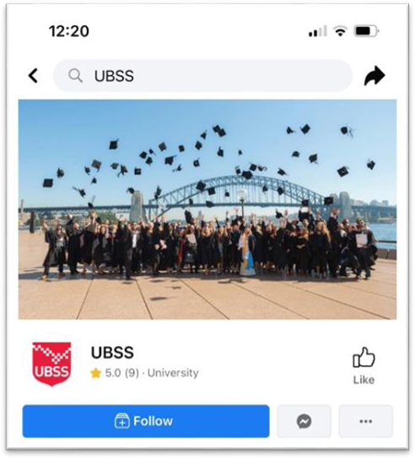
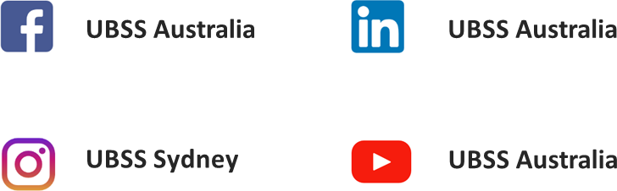
Social Media
Social media is a very important part of UBSS student experience. We strive to provide our students with high- quality, relevant and useful content at UBSS.
We provide daily content related Business, Entrepreneurship, management and UBSS related news.
We invite all students to like and follow our social media accounts, including Facebook, Instagram, LinkedIn and YouTube

Slide 35



Policies & Procedures
Other Procedures

Slide 36
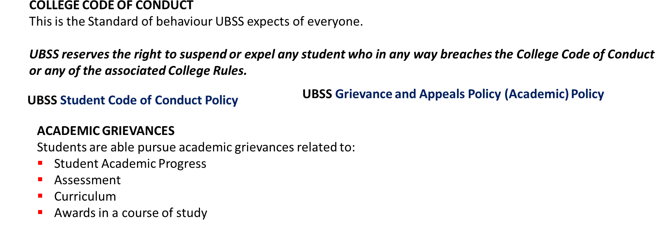
Policies and Procedures
You can find all UBSS Policies and Procedures on our website.
https://www.ubss.edu.au/policies-and-procedures

Slide 37
Policies and Procedures
Process for Student Grievances and Appeals (Academic and Non-Academic)
If you have a grievance, your first point of contact should be Student Services or the Student Success Manager, as per existing policies. You can reach them in person during UBSS opening hours, or via email or telephone.
You can also schedule appointments with your Academic Programs Director to address any issues related to your experience at UBSS.
Please follow the procedures outlined in the relevant policies, such as the Grievance and Appeals policies (Academic and Non-Academic) and the Student Code of Conduct.
If you are not satisfied with the outcome after following these procedures, you may contact the Commonwealth Ombudsman for higher education student complaints: https://www.ombudsman.gov.au/complaints
You may also contact the National Student Ombudsman at any time: https://www.nso.gov.au/

Slide 38

Compliance (DHA)
Department of Home Affairs (DHA)
DHA deals with:
- Students visas
- Student visa holders monitoring
DHA is interested in:
- Your academic progress
- Where you live (via your myGCA account)
- Your employment
Important: Group Colleges Australia / UBSS have a legal responsibility to report students who do not meet the DHA requirements.

Slide 39


Compliance (DHA)

Slide 40
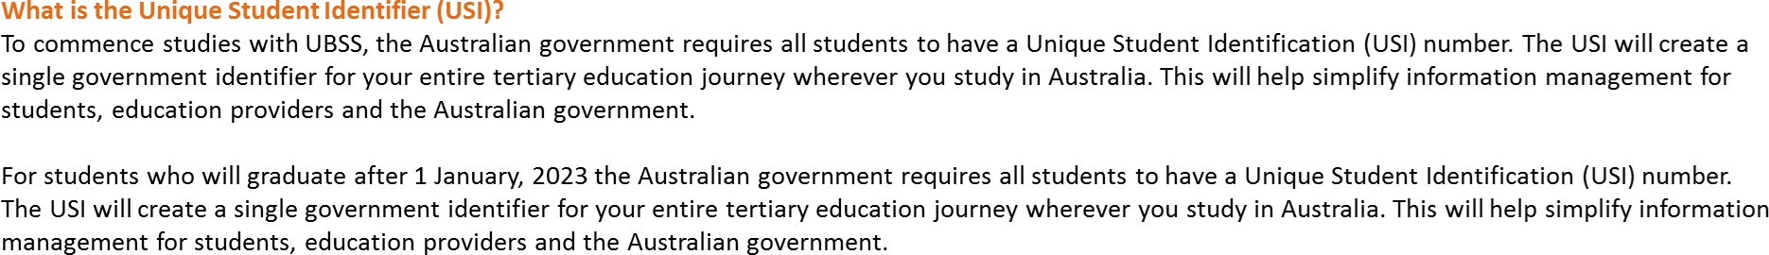
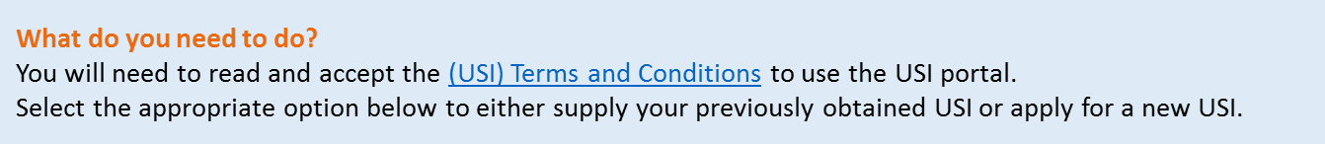
Unique Student Identifer (USI)

Slide 41
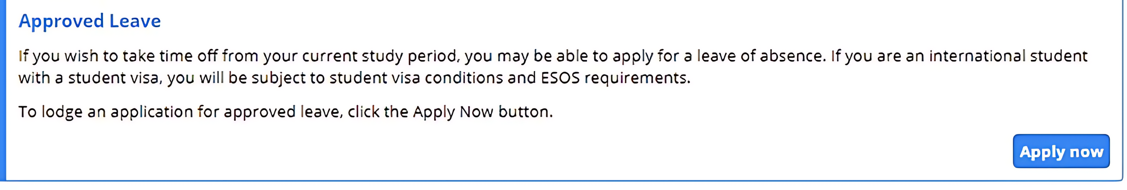

Medical Leave
Apply for Medical Leave via MyGCA / Student Services Online / Support Services / Approved Leave
When you visit your Doctor ask for a medical certificate.
Doctors are registered with the Australian government and will have a Medicare Provider Number.
UPLOAD YOUR MEDICAL CERTIFICATE and other documents where applicable.
You must keep the original of all medical documents.
DHA may wish to view the document.

Slide 42

Holidays
End of trimester holidays are listed on your Academic Calendar available on the
UBSS Student Central website.
https://www.ubss.edu.au/academic-calendar/
If you would like to apply for holidays during your regular study periods you will need to apply for a deferment (3-month leave). For more information about this, please see our Course Deferral Policy at https://www.ubss.edu.au/policies-and-procedures/
Please send all Deferment enquiries to info@ubss.edu.au

Slide 43
Refund & Cancellation
The Refund Policy is outlined in your Offer Letter.
For more details refer to:
Fees and Refund Policy
https://www.ubss.edu.au/policies-and-procedures/
Information on Tuition Protection Service
https://www.ubss.edu.au/tuition-protection-service/

Slide 44


Security and Health
Security
UBSS Melbourne CBD Campus has 24/7 security cameras to ensure your safety on campus.
DO NOT leave your belongings unattended anywhere.
Health
For all health-related matters you can visit the nearest Medical Centre, Swanston Street Medical Centre.
Telephone: +61 3 9205 7500
Address: Level 3, 255 Bourke Street Melbourne VIC 3000

Slide 45

First Aid
There are First Aid Officers on campus.
Please visit Student Services if in need of medical assistance or call triple zero (000)

Slide 46
Places of Worship
There are no prayer rooms on campus.
Please visit the link below to find places of worship near the campus.
https://insiderguides.com.au/finding-faith-in-melbourne/

Slide 47
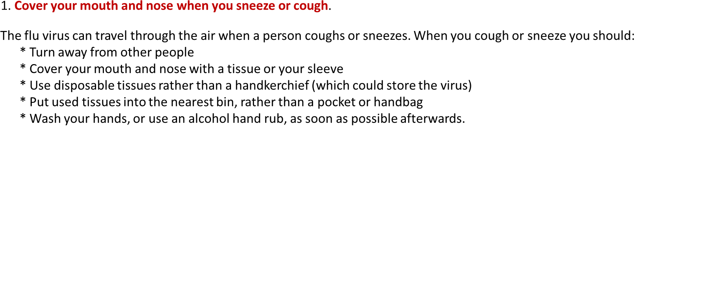


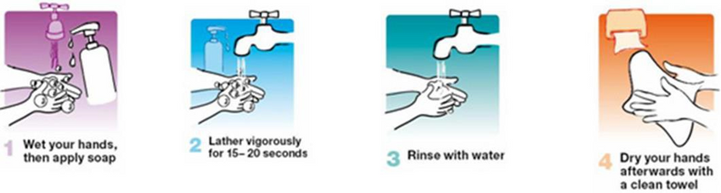
Hygiene on Campus

Slide 48

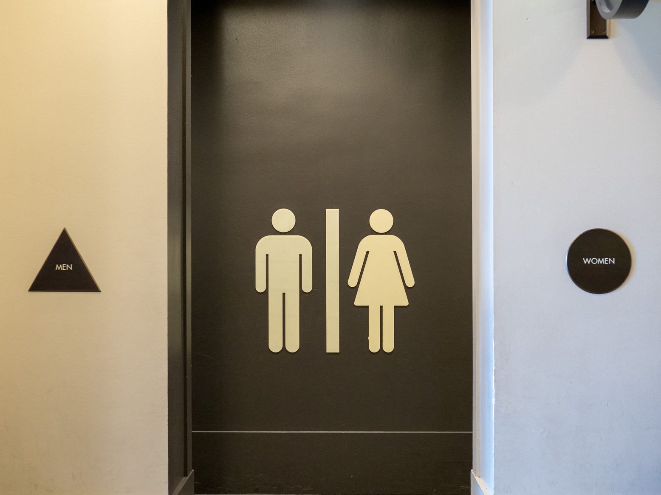
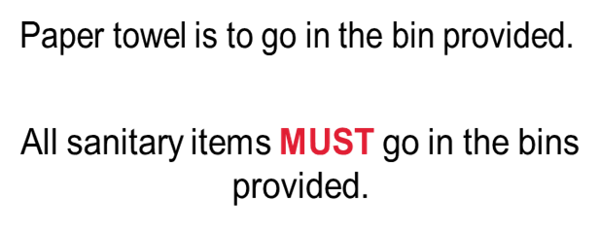
Hygiene on Campus
Students are to keep bathrooms clean and tidy.
Consider others – clean up after yourselves.

Slide 49
Please remember…

Slide 50
Wellness and Support
At UBSS we focus on all aspects of student wellness and creating a safe environment for all students.
UBSS has a dedicated WHS & Wellness Committee and support staff who are the first point of contact if you feel unsafe.
If an incident were to occur on the premises during class hours, inform your lecturer/facilitator and/or contact the following staff:
George Lai – Campus Manager, Melbourne CBD campus
George.Lai@ubss.edu.au
Dr Mack Meshkati - Student Success Manager, Melbourne CBD campus
Mack.Meshkati@ubss.edu.au
Visit https://www.ubss.edu.au/policies-and-procedures/
  Student Sexual Misconduct, Prevention and Response Policy
  Health, Safety and Wellbeing Policy

Slide 51
Counselling
Are you having personal problems?
Do you need to talk to someone?
GCA suggests the following:
Contact Overseas Student Health Cover (OSHC)
https://oshcaustralia.com.au/en
or Call: Lifeline on 13 11 14 or Beyond Blue on 1300 22 4636

Slide 52
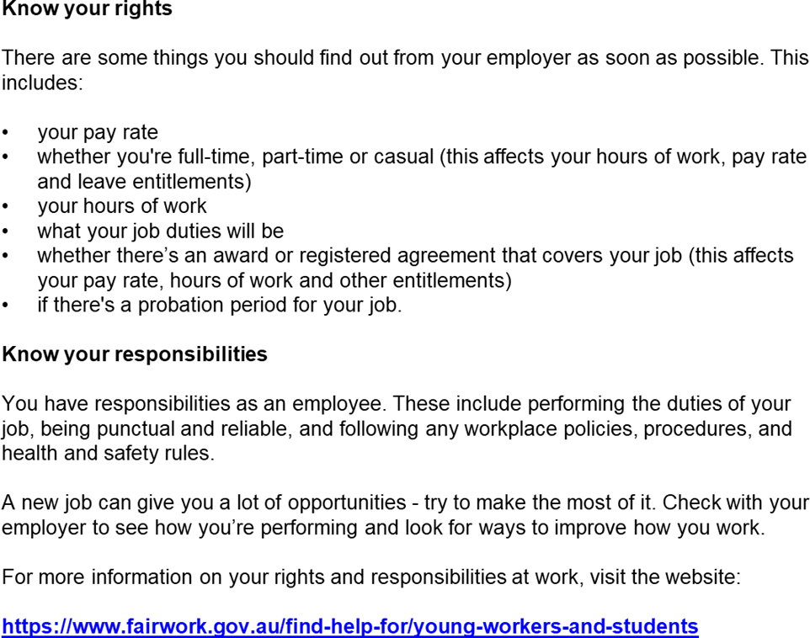


What are your rights at work?

Slide 53
Important: Pay your fees
You will be non-compliant with the conditions of your Student VISA
Your CoE will be cancelled, and the DHA will be informed
You will not have access to your myGCA account
You will not have access to our online course materials on Moodle
You cannot sit assessments
You may be reported to debt collectors

Slide 54

Thank you and
Welcome to UBSS!!

