Slide 1






STUDENT ORIENTATION
ADELAIDE CAMPUS
Trimester 4, 2025
A very warm welcome to our New Students from the UBSS Staff.

Slide 2
Today’s Topics
Welcome message
Introduction to UBSS
Living in Australia
Living in Adelaide
Our Adelaide Campus
Key UBSS Staff
Academic Support Services
Non-Academic Support Services
Communication
Important Procedures
Facilities and Resources
Policies and Procedures
Reminders

Slide 3

Acknowledgement of Country
We acknowledge the Traditional Custodians of the lands and waters across Australia where our campuses are located and where we gather to meet and learn. Today, I honour the Gadigal people of the Eora Nation, on whose land we are based and all the lands we gather from today.
We pay respect to Elders past and present, whose wisdom, cultural heritage and care for these lands have guided countless generations, just as we strive to guide our students. Inspired by their commitment to learning and community, we walk together toward a future of mutual respect, understanding, and shared opportunity.

Slide 4
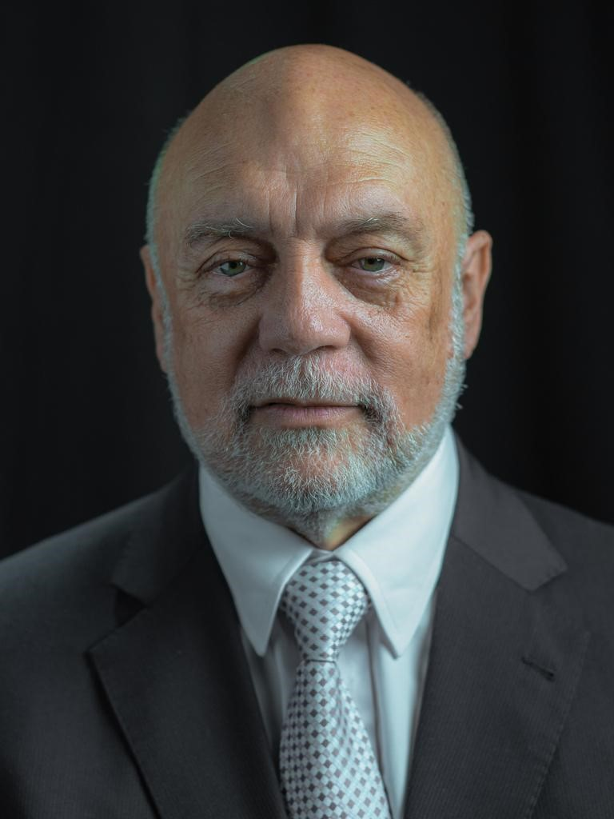
Welcome Message
Dear Students,
Welcome to Universal Business School (UBSS)
You are embarking on an exciting journey of learning and growth. At UBSS, we are dedicated to providing you with the knowledge, skills, and support needed to excel in your chosen field. Our focus is on practical, industry-relevant education, equipping you to thrive in an ever-changing world.
Your time here is a unique opportunity to challenge yourself, explore new ideas, and build lifelong connections. Make the most of it, and remember, our team is here to support you every step of the way.
We are thrilled to have you join our community and can’t wait to see all that you will achieve.
Professor Alan Bowen-James
Chief Executive Officer (Interim)
Chief Academic Officer (Interim)
Group Colleges Australia

Slide 5

Introduction to UBSS

Slide 6
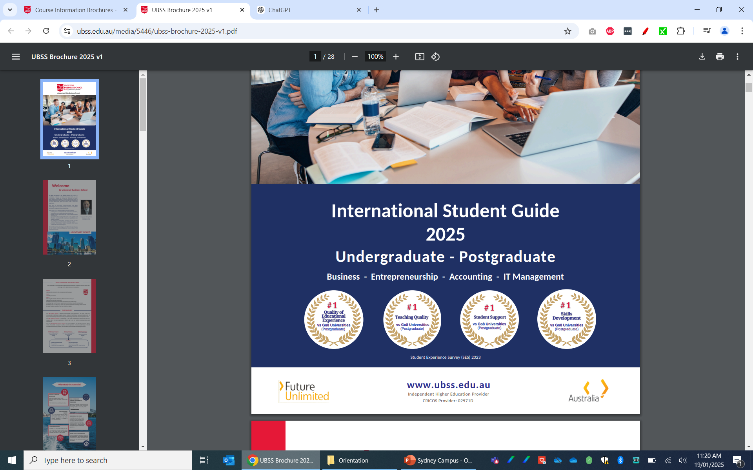

Introduction to UBSS
Student Experience Survey
(2023)
UBSS is a nationally recognised business school and higher
education provider of undergraduate and postgraduate programs that prepare you for the challenges of the global business marketplace.
Our Programs
Bachelor of Accounting
Bachelor of Business
Master of Business Administration (MBA)
Accounting
Entrepreneurship
IT Management

Slide 7
Introduction to UBSS
UBSS Mission
UBSS launches careers for the entrepreneurs of the future
UBSS Motto
“Launch Your Career"
UBSS Values
Delivering the Bachelor of Business, Bachelor of Accounting and MBA with an Australian experience.
Providing a learning environment for the entrepreneurs of the future offering a high level of student support and care to deliver a quality learning space providing access to online and classroom education technology for all students ensuring academic excellence & free intellectual Inquiry.
08

Slide 8
Introduction to UBSS
Our commitment:
It is the School’s objective to prepare you to be work ready in the business world after completion of your degree.

Slide 9


UBSS Governance
Universal Business School Sydney (UBSS) is a trading name of Group Colleges Australia (GCA), an educational institution based in Australia. The Board of Directors has ultimate responsibility for GCA performance and operations as an accredited higher education provider. Academic governance is delegated to the Academic Board (AB) by the Board of Directors in accordance with GCA’s Constitution. Management is delegated to the Chief Executive Officer, who is supported by the Executive Leadership Team and committees that monitor and advise on health and safety, staff and student wellbeing and operational matters.
Governance and Leadership

Slide 10



UBSS Registration
UBSS is registered as a higher education provider in Australia by the Tertiary Education Quality and Standards Agency (TEQSA). The Tertiary Education Quality and Standards Agency (TEQSA), registers all Australian institutions, including government and private universities, that offer courses at the higher education (tertiary level) and accredits their courses for delivery in Australia and/or offshore locations.
CRICOS is the Commonwealth Register of Institutions and Courses for Overseas Students. CRICOS registration means that UBSS is authorised by the Australian government to enrol international students in its courses.
When you attend university or an approved higher education provider, you can get a FEE-HELP loan to pay all or part of your tuition fees (for Australian citizens and some special New Zealand visa holders only).
Registration and Accreditation

Slide 11



Professional Accreditation

Slide 12

Living in Australia
"Australia is a stable, democratic and culturally diverse nation with a highly skilled workforce and one of the strongest performing economies in the world.”
International students - Things You Should Know (Living In Australia)
Global Recognition Growing Destination Multicultural Society
Safe Environment Cost of Living Work

Slide 13

Living in Australia
Important information while living in Australia:
Emergency Contacts: 000 (triple zero) = emergency number in Australia
https://www.triplezero.gov.au
Safe work in Australia: work health and safety (WHS) information
https://www.safeworkaustralia.gov.au/
Beach Safety: https://www.healthdirect.gov.au/beach-safety
Key facts:
•Always swim between the red and yellow flags on patrolled beaches
•Always swim with someone else
•Never swim after drinking alcohol or taking drugs
Overseas Student Health Insurance:
https://www.studyaustralia.gov.au/en/plan-your-move/overseas-student-health-cover-oshc
Legal Advice: https://lsc.sa.gov.au/

Slide 14

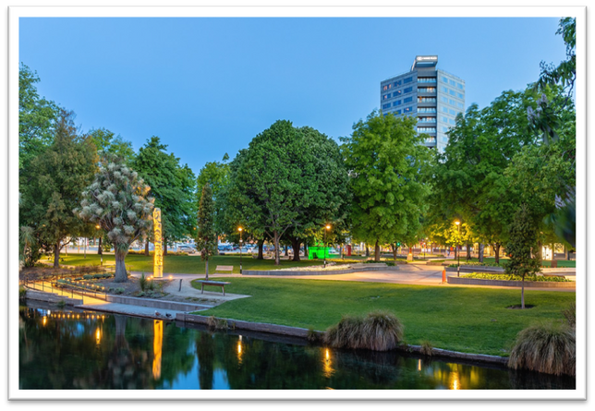
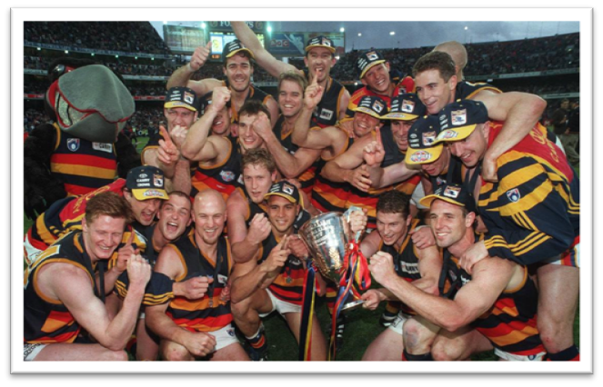
Living in Adelaide
Adelaide, located in South Australia, is a vibrant and welcoming city with a population of over 1.3 million people. Known for its Mediterranean climate, beautiful beaches, and world-renowned wine regions, Adelaide offers an enviable lifestyle. The city boasts a thriving arts and cultural scene, excellent food and wine, and easy access to nature reserves and wildlife parks. Adelaide's affordable cost of living and high standard of living make it an ideal destination for both students and professionals. Living In Adelaide

Slide 15
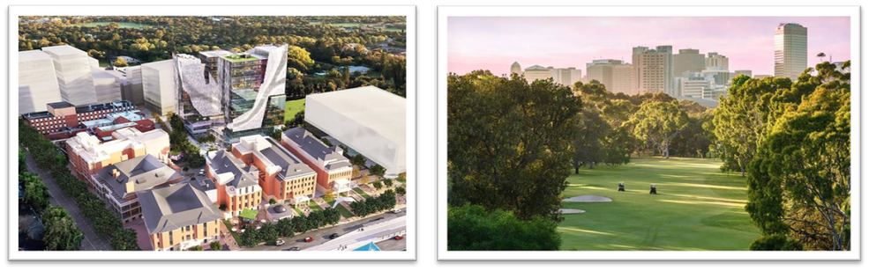

Living in Adelaide
Adelaide is a city that's brimming with culture, entertainment, and delectable flavours. You can indulge in the world-renowned wine regions located just a few minutes away from the city, bask in the sun at the picturesque metropolitan beaches, partake in the immersive festivals and events, or revel in the bustling restaurant and bar scene that Adelaide has to offer. Adelaide is a gateway to some of Australia’s best wine country with tourist attractions including lush parklands and some of the country’s best beaches.
Find more information about living and Adelaide, including Cost of Living here:
Living In Adelaide

Slide 16
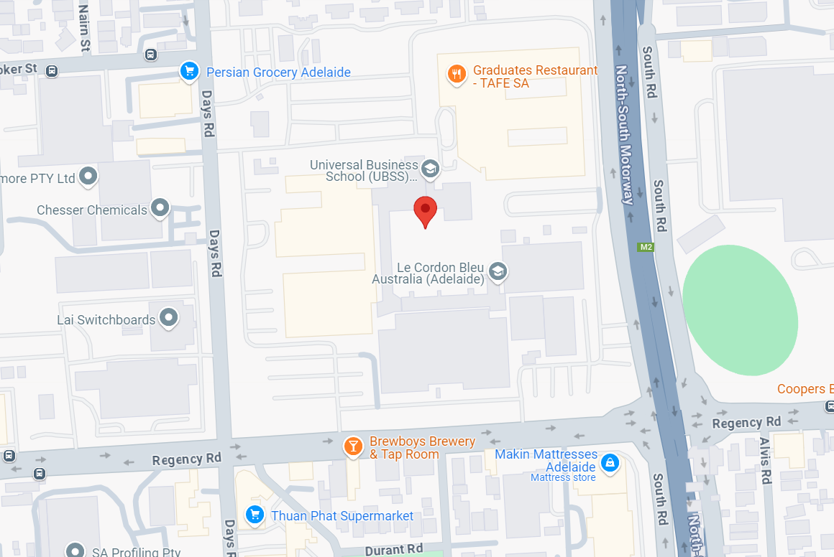
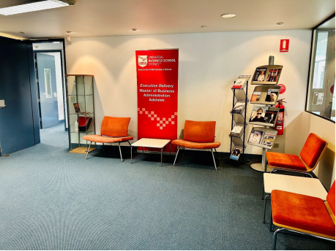
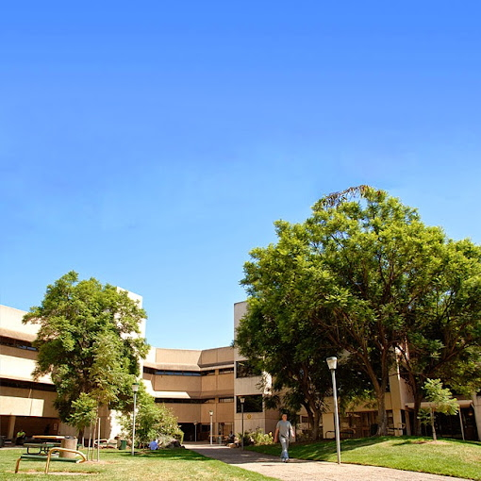
Our Adelaide Campus
The UBSS Adelaide campus is located within the TAFE SA Regency campus.
Enter via Entrance 2 on Days Road.
137 Days Road, Regency Park SA 5010

Slide 17
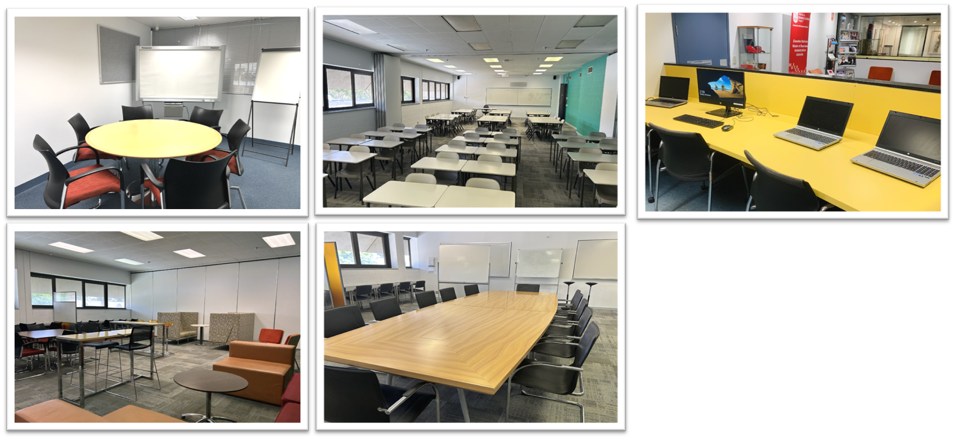
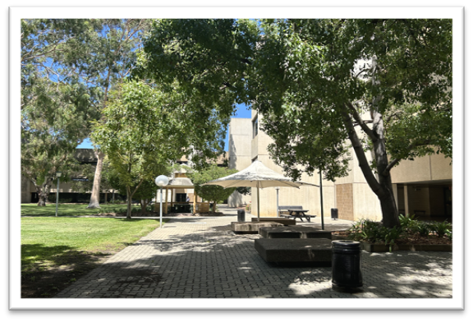
Our Adelaide Campus

Slide 18

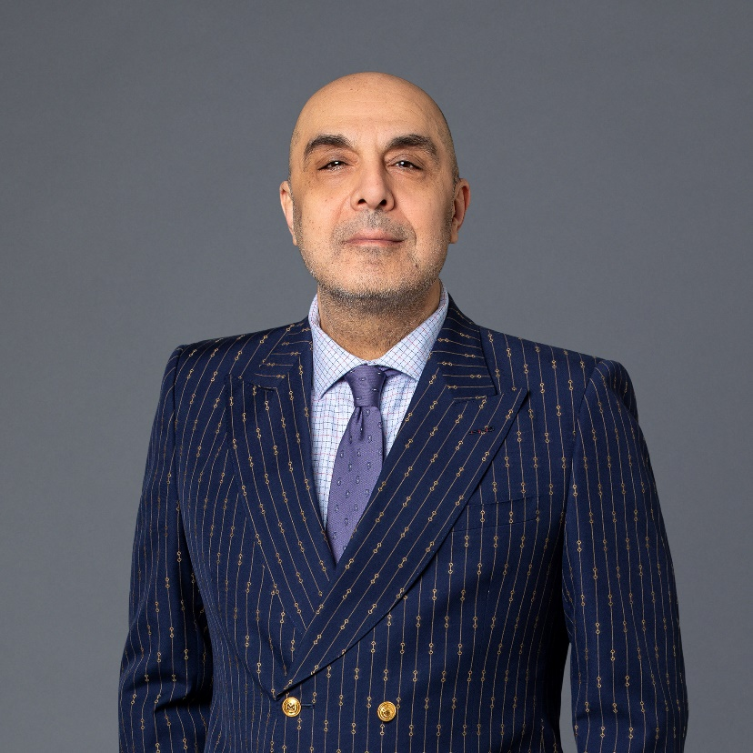
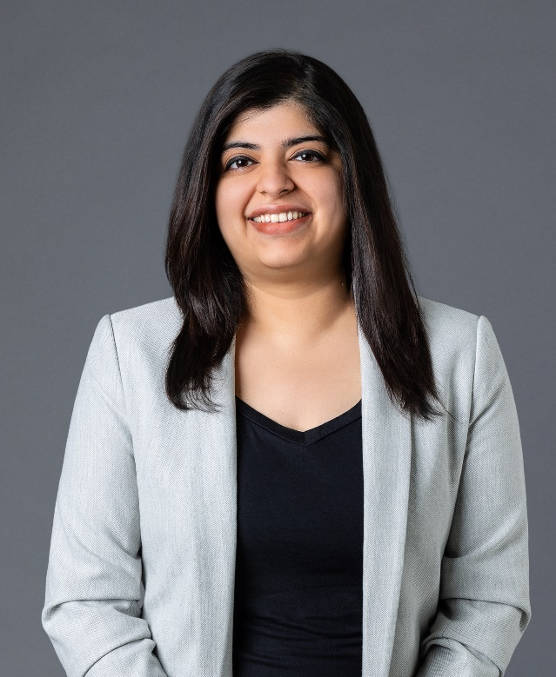
Key UBSS Staff
Associate Professor Wayne Smithson
Academic Programs Director
Subject Matter Expert (SME) Project Lead
Sydney CBD campus
wayne.smithson@ubss.edu.au
Anushka Khatri Registrar & Campus Manager - Adelaide
Anushka.khatri@ubss.edu.au
Dr Mack Meshkati
Student Success Manager / Senior Lecturer
Melbourne CBD Campus
Mack.Meshkati@ubss.edu.au

Slide 19
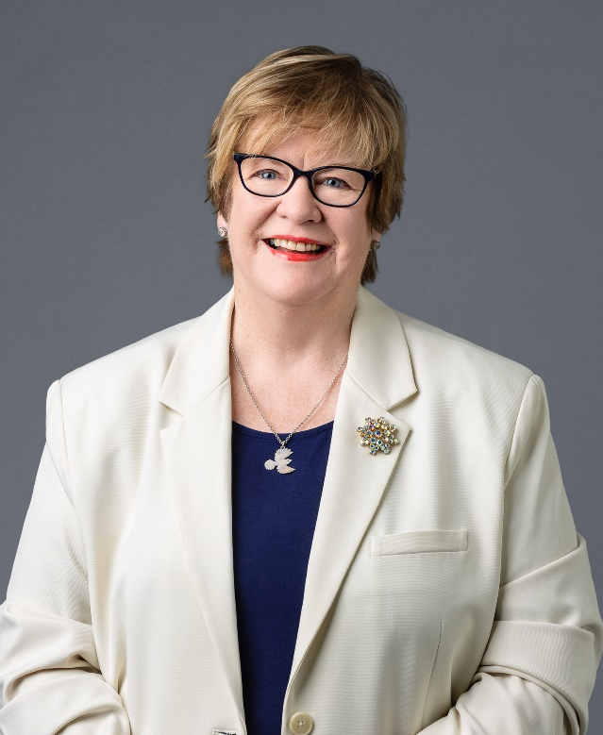
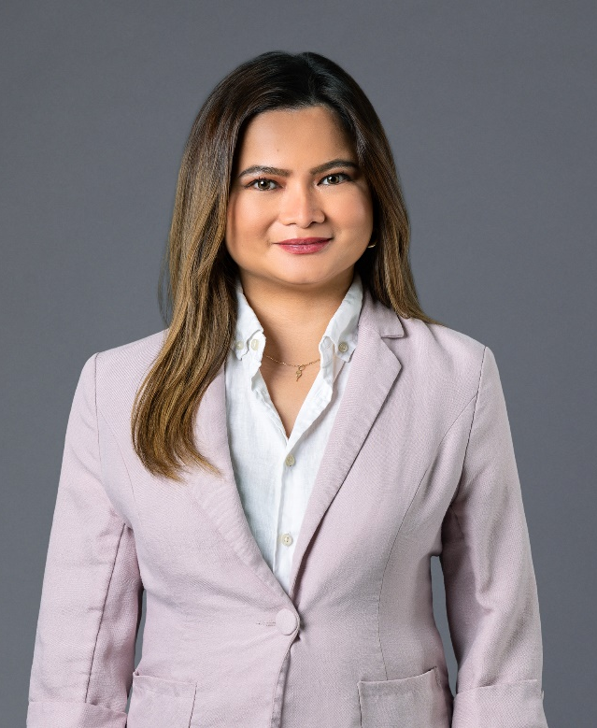
Key UBSS Adelaide Staff
Caroline Rowe
Lecturer & Campus Academic Lead
Caroline.rowe@ubss.edu.au
Nikki Paz Academic Support & Administration Officer
Nikki.paz@ubss.edu.au

Slide 20
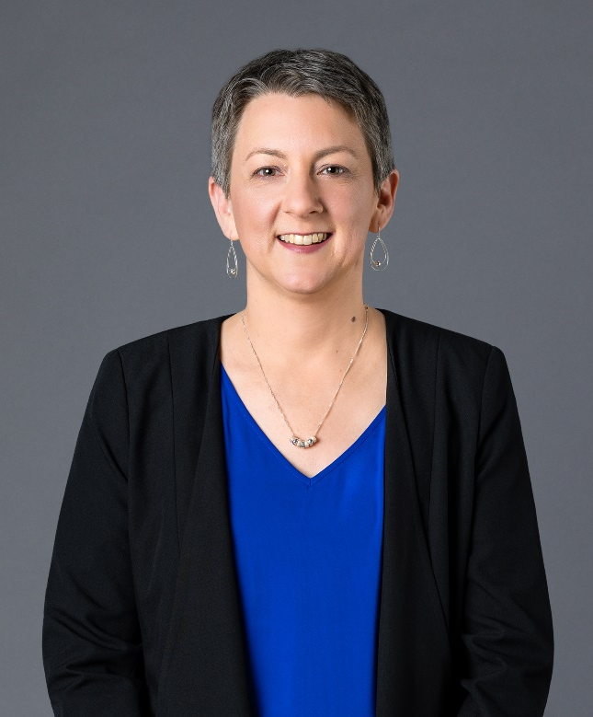
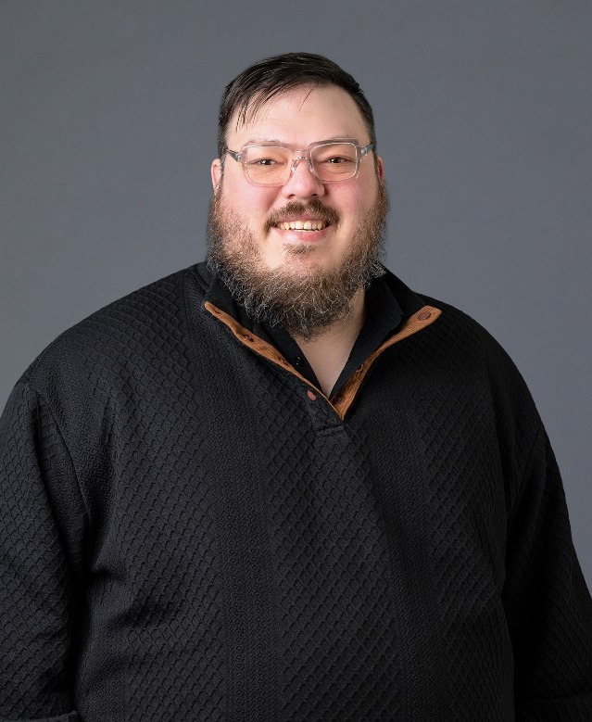
Key Online MBA Staff
Melissa Krollig Academic Administration and Learning Resources Manager ecarer@ubss.edu.au
Michael Cheel Learning Resources Coordinator, & Onsite IT Support
ecarer@ubss.edu.au
Note: As ‘on campus’ students, you likely will not need to contact these team members, however you may see them around campus.

Slide 21
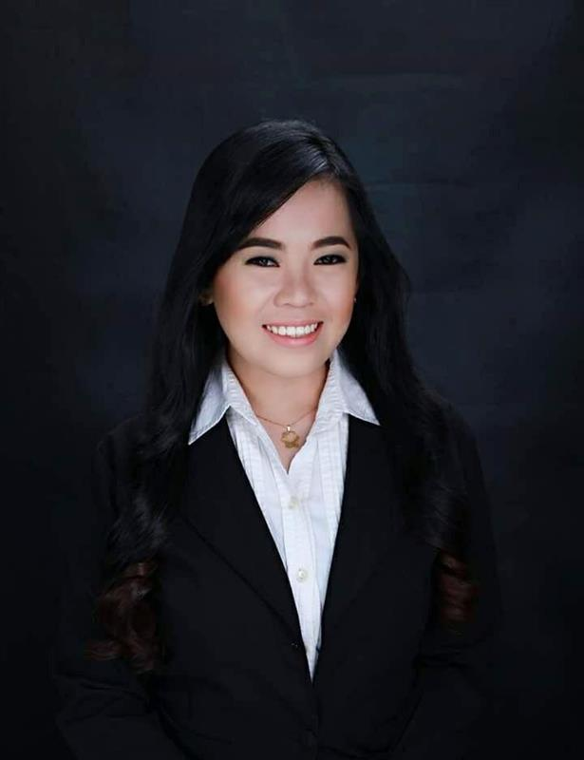
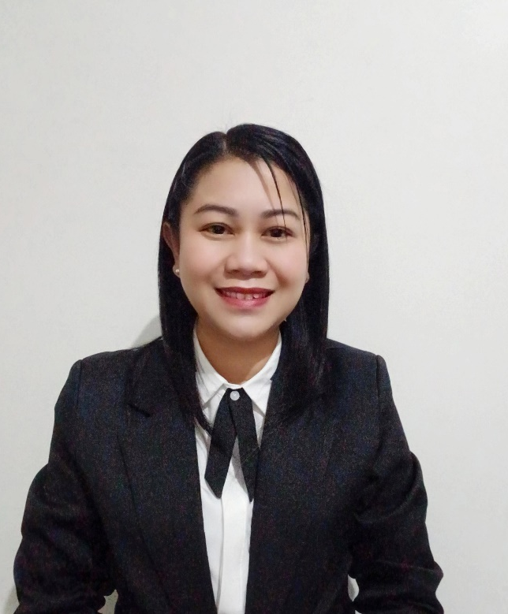
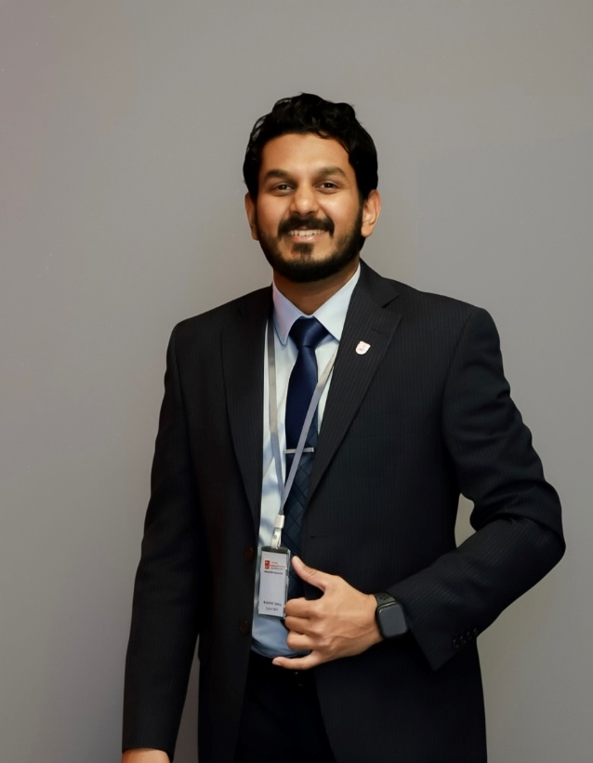
Duty Officers
Johana Rica Lavilla
Shiery Lou Fegarido
Janith Peiris
Note: As ‘on campus’ students, you likely will not need to contact these team members, however you may see them around campus.

Slide 22
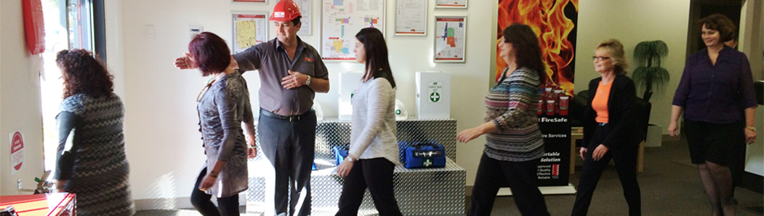
Campus Evacuation Procedure
Instructional videos are provided for students to familiarise themselves with emergency procedures.
Please watch the video here: Emergency Evacuation Procedures
During an evacuation, please remain calm, follow staff instructions, and proceed quickly to the designated assembly point for your safety.

Slide 23
Campus Evacuation Procedure
Fire wardens - Melissa
First aiders – Duty Officers

Slide 24
Powerboards and extension cables
Students are advised to fully charge their electronic devices before attending classes and assessments. Powerboards and extension cables will not be provided.

Slide 25
Academic Support Services

Slide 26


Academic Staff Roles
The Lecturer will be responsible for:
Direct teaching on their specialist subject
Creating teaching materials
The Tutor will be responsible for:
Delivering the tutorial materials
Invigilating in-class assessments for their subject cohort
Mark all assessments
The Student Success Manager will be responsible for:
Supporting students' academic growth and success
Providing academic support and tailored learning assistance

Slide 27
Student Success
Focus areas include –
Assisting students with their learning and associated skills development;
Providing individual advise and guidance to students on a range of matters academic;
Providing individual consultation with students as required;
Providing lecture and tutorial support as required;
Assisting with bookings as required;
Working co-operatively with the campus staff to create a positive and welcoming environment; and taking an active role in hybrid and face to face supervision.

Slide 28
Other Student Success Services
Academic Monitoring and Intervention Management -
Academic Progression, Monitoring and Intervention Policy on the website – Policies & Procedures
Learning Resources, Reading Subjects & Student Central - Student Central
Video recordings of class lectures via Moodle
E-libraries
MBA TV for subject content support

Slide 29
Student Success
Student Success
Official Point of Contact
For all enquiries regarding the support services that UBSS offers to students, please contact:
Student Services
1300 422 422
studentservices@gca.edu.au
Nikki Paz Academic Support & Administration Officer
Email: Nikki.paz@ubss.edu.au
Booking Appointments
Book an appointment with the Student Success Manager via the UBSS Mobile app.
Appointments will be held on Microsoft Teams or face to face as advised by the Student Success Manager.

Slide 30
Non-Academic Support Services

Slide 31
Non-Academic Student Support
Non-Academic support services include –
Assisting students with enrolment processes
Activating student accounts both in the learning management system (LMS) and the student management system (SMS)
Ensuring ongoing access to the necessary applications and software
Supporting enrolment variations
Providing directory assistance
Enabling leave applications
Ensuring student welfare and being available to students for a range of other queries in a timely way.

Slide 32
Non-Academic Student Support
Other Non-Academic Support Services include:
Wellness Support
Student Orientations: Refer to the website for the
Student Orientation Page
Student Orientation Policy
Equity and Diversity
Refer to the website for the below policies:
Equity, Diversity and Inclusion Policy
Indigenous Australian Education Policy
Mental Health of Students Policy
Health, Safety and Wellbeing Policy

Slide 33
Non-Academic Student Support
For further Student Support and other essential information to help you navigate studying, living, and working in SA as a student. please visit : International Education – Support International Students Education & Learning – Student Support Programs
Language and interpreter services
Living in SA (including accommodation information)
Identity cards and documents
Safety and emergency help
Health and wellbeing
Transport and travel
Financial Support for Students - ask our Student Services Department for more information or visit: International Education – Financial Assistance Education & Learning – Financial Help, Scholarships & Grants

Slide 34
Communication

Slide 35
Communication
Effective communication between UBSS and students is VERY important.
The main ways of communicating:
GCA Webmail: all students have an email account (studentID@studentmail.gca.edu.au).
SMS to mobile: text messages are sometimes sent for urgent messaging.
UBSS Mobile App: we might send you notifications via your UBSS Mobile App, so make sure you download it.
myGCA Bulletin: bulletins are sent out so you don’t miss anything important. They will automatically appear once you log into your myGCA account.
TV Monitors: these are placed all over campus to provide you with student information and occasionally some “words of wisdom”.
Online Surveys: we like to hear from you. Through our online surveys we manage student satisfaction and feedback.

Slide 36
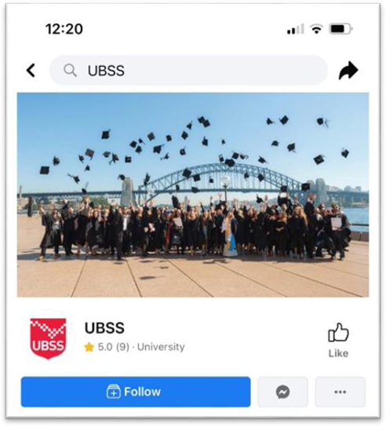

Social Media
Social media is a very important part of UBSS student experience. We strive to provide our students with high- quality, relevant and useful content at UBSS.
We provide daily content related Business, Entrepreneurship, Management and UBSS related news.
We invite all students to like and follow our social media accounts, including Facebook, Instagram, LinkedIn and YouTube

Slide 37
Policies & Procedures
Other Procedures

Slide 38
Policies and Procedures
You can find all UBSS Policies and Procedures on our website under External Policies. https://www.ubss.edu.au/policies-and-procedures
All students are required to understand and follow the GCA policies. If you are unclear on any parts of policy, please reach out to Student Services.
The policies cover topics such as:
Please ensure you are familiar with the policies.
UBSS reserves the right to suspend or expel any student who in any way breaches policy.
Admissions
Enrolment
Progression
Academic Integrity
Misconduct
Complaints (grievance) and Appeals
Support and Safety

Slide 39
Policies and Procedures
Process for Student Grievances and Appeals (Academic and Non-Academic)
If you have a grievance, your first point of contact should be Student Services or the Student Success Manager, as per existing policies. You can reach them in person during UBSS opening hours, or via email or telephone.
You can also schedule appointments with the Academic Programs Director to address any issues related to your experience at UBSS.
Please follow the procedures outlined in the relevant policies, such as the Grievance and Appeals policies (Academic and Non-Academic) and the Student Code of Conduct Policy. Available on the website
If you are not satisfied with the outcome after following these procedures, you may contact the Commonwealth Ombudsman for higher education student complaints: HERE You may also contact the National Student Ombudsman at any time: HERE

Slide 40

Compliance (DHA)
Department of Home Affairs (DHA)
DHA deals with:
- Students visas
- Student visa holders monitoring
DHA is interested in:
- Your academic progress
- Where you live (via your myGCA account)
- Your employment
Important: Group Colleges Australia / UBSS have a legal responsibility to report students who do not meet the DHA requirements.

Slide 41


Compliance (DHA)

Slide 42
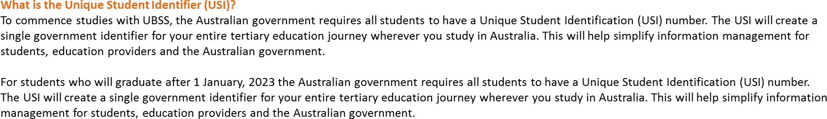
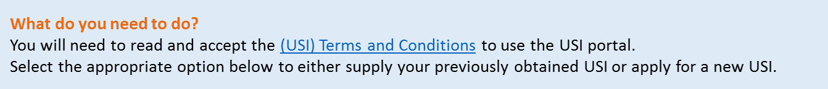
Unique Student Identifer (USI)

Slide 43
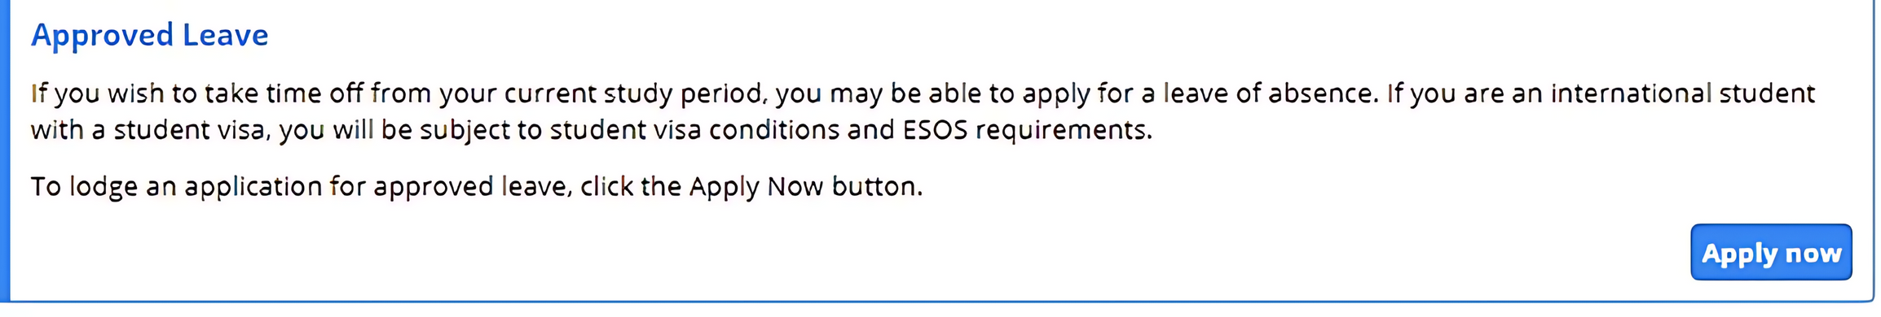

Medical Leave
Apply for Medical Leave via MyGCA / Student Services Online / Support Services / Approved Leave
When you visit your Doctor ask for a medical certificate.
Doctors are registered with the Australian government and will have a Medicare Provider Number.
UPLOAD YOUR MEDICAL CERTIFICATE and other documents where applicable.
You must keep the original of all medical documents.
DHA may wish to view the document.

Slide 44

Holidays
End of trimester holidays are listed on your Academic Calendar available on the
UBSS Student Central website.
If you would like to apply for holidays during your regular study periods you will need to apply for a deferment (3-month leave). For more information about this, please see
our Deferment Policy.
Please send all Deferment enquiries to info@ubss.edu.au

Slide 45
Refund & Cancellation
The refund and cancellation policy is outlined in your Offer Letter.
For more details refer to:
Fees and Refund Policy
Course Deferral Policy
Information on Student Tuition Protection Scheme

Slide 46

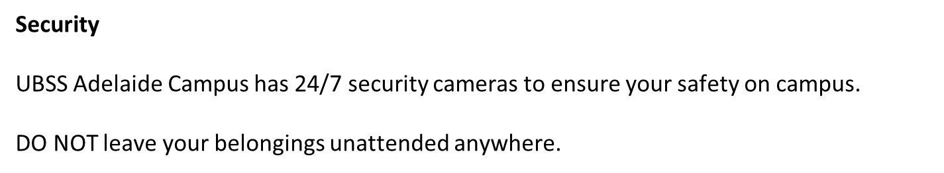
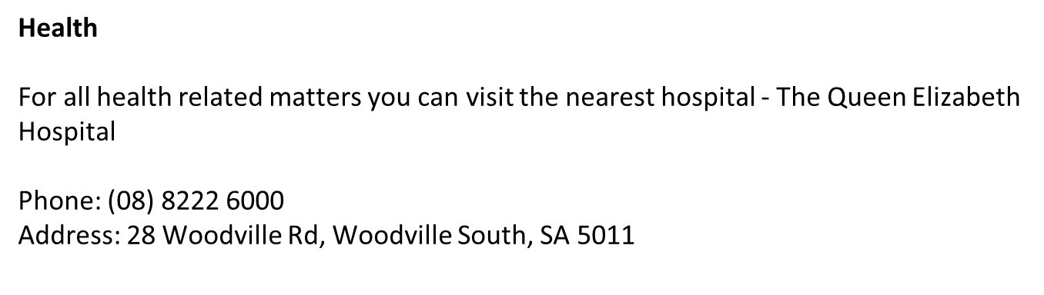

Security and Health

Slide 47


First Aid
Please visit Student Services if in need of medical assistance or call triple zero (000)

Slide 48
Places of Worship
Please note that there are no prayer rooms available on Level 2 – C Block. However, TAFE SA , Regency Campus - C Block Level 1 has a prayer room that can be accessed when needed.
Alternatively, you can visit the link below to find places of worship near the campus: HERE

Slide 49
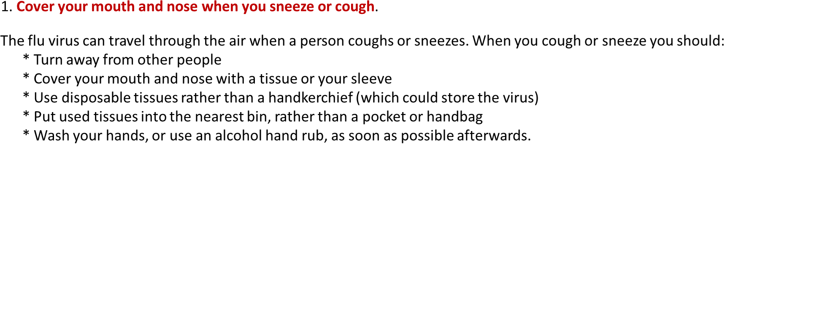


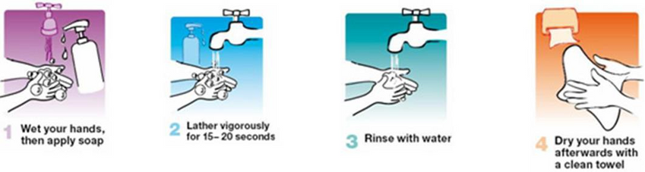
Hygiene on Campus

Slide 50

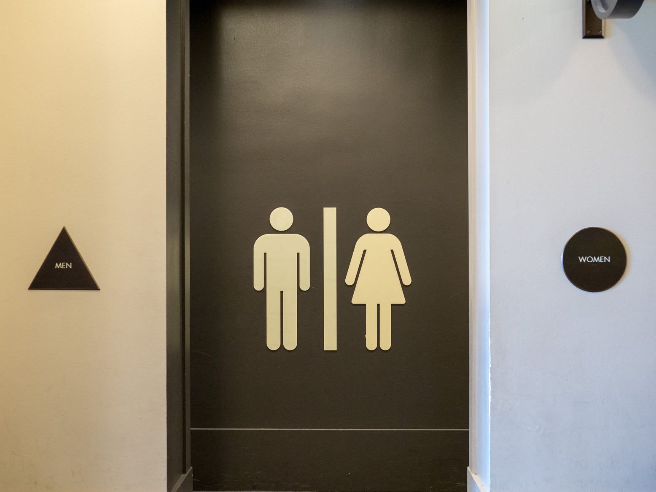
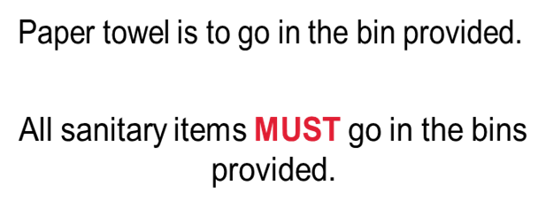
Hygiene on Campus
Students are to keep bathrooms clean and tidy.
Consider others – clean up after yourselves.

Slide 51
Please remember…

Slide 52
Wellness and Support
At UBSS we focus on all aspects of student wellness and creating a safe environment for all students.
UBSS has a dedicated WHS & Wellness Committee and support staff who are the first point of contact if you feel unsafe.
If an incident were to occur on the premises during class hours, inform your lecturer/tutor and/or contact the following staff:
Anushka Khatri – Campus Manager, Adelaide Regency Park campus Anushka.Khatri@ubss.edu.au
Dr Mack Meshkati - Student Success Manager, Melbourne CBD campus
Mack.Meshkati@ubss.edu.au
For more information, view the following policies on the Website
Student Sexual Misconduct, Prevention and Response Policy
Health, Safety and Wellbeing Policy

Slide 53
Counselling
Are you having personal problems? Do you need to talk to someone?
GCA suggests…
Contact Overseas Student Health Cover (OSHC) provider
https://oshcaustralia.com.au/en
Call Lifeline 13 11 14
Beyond Blue 1300 22 4636

Slide 54
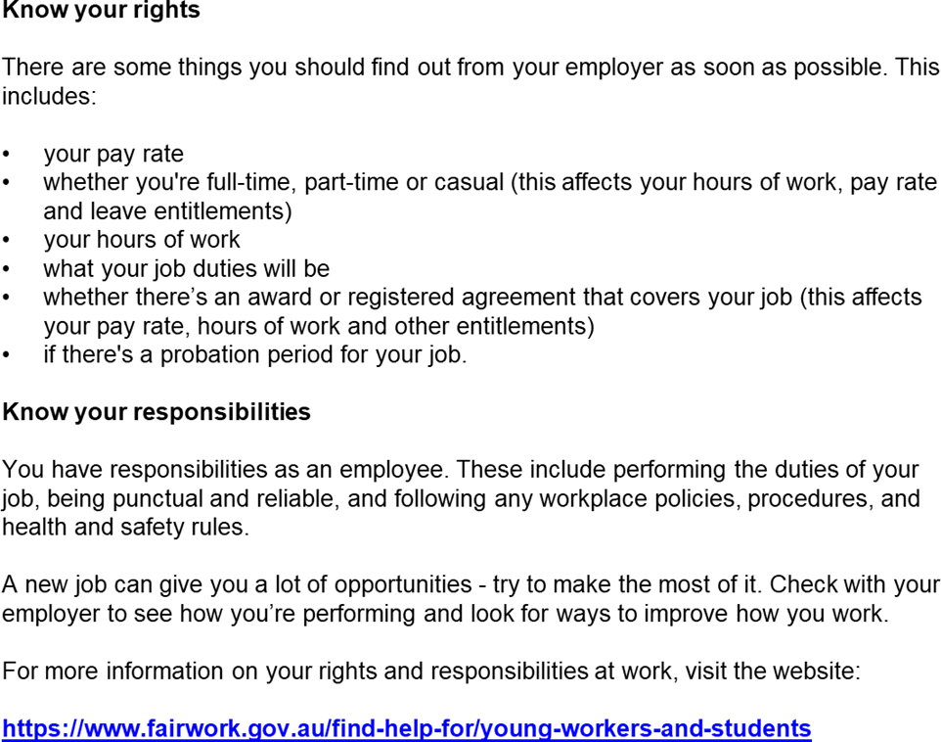


What are your rights at work?

Slide 55
Important: Pay your fees
Avoid being in breach of the conditions of your Student VISA
Your CoE may be cancelled, and the DHA will be informed
You will not have access to your MYGCA account
You will not have access to our online course materials on Moodle
You cannot sit assessments

Slide 56

Thank you and
Welcome to UBSS!!

